Slide 1

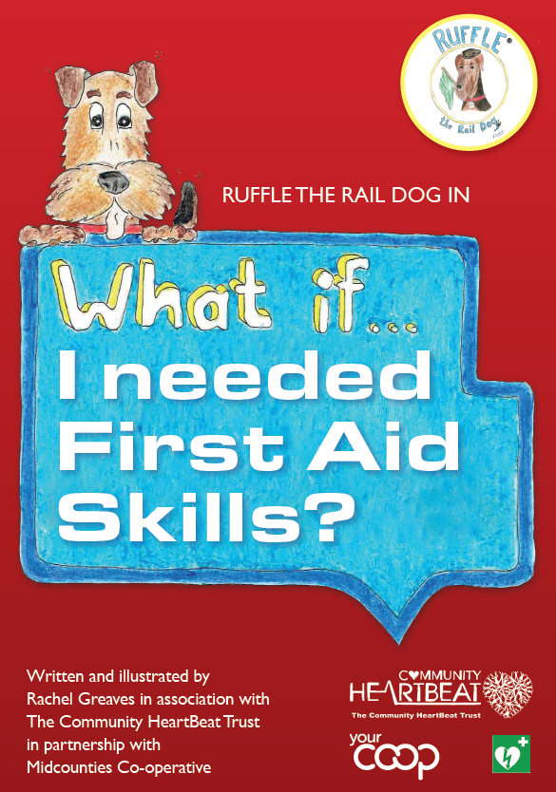
Notes:
Good morning. My name is …………….. I am a ……………………….(job) For the Coop at …………………….(site)
For the past 6 months we have been fundraising to buy you some special books to show you what to do in case there is an accident. The book is called Ruffle the Rail Dog ‘What if…. I needed first
aid skills’ to help you know what you can do to help
We raised the money and we’ve given the books to the school today! The book has lots of different chapters on things like what to do if someone has a nosebleed or a burn or someone is choking. You’ll be learning about all of that with your teachers and there’s lots of colouring and activities to do whilst you learn

Slide 2
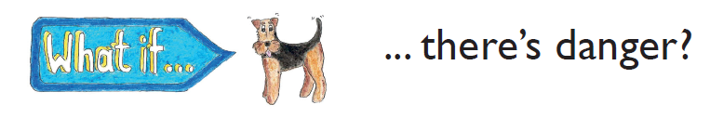

IS IT SAFE?
LOOK FOR DANGER
Notes:
Today, I’m going to give you just as a taste of what is in the book we’re going to talk about seeing danger, what to do and calling 999

Slide 3
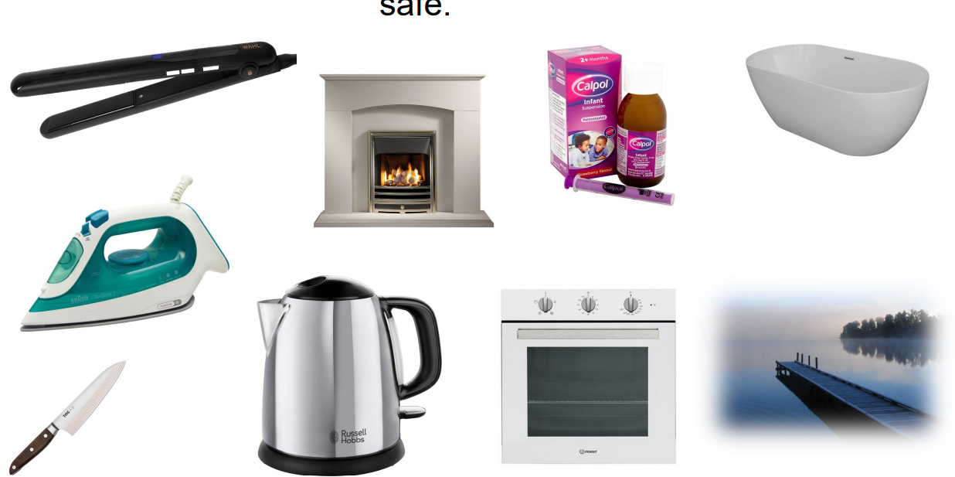
I know about dangerous things and how to keep safe
Notes:
What dangerous things can they see? Hands up who knows what one of the items in the picture is and why it’s dangerous.
• Hair straighteners - burn - Don’t touch • Calpol/Medication - make child sick - Don’t touch/put in mouth • Knives - cut - Don’t touch • Fire - burn - Don’t go near
Kettle - burn - don’t touch • Iron - burn - don’t touch • Oven - burn - don’t touch • Bath - drown - make sure adult is with you, play safely • Open water - drown - be careful around, make sure adult is with you
What other unsafe things can the children think of? Can they see any things in the environment? Have their parents ever told her to be careful with anything?

Slide 4
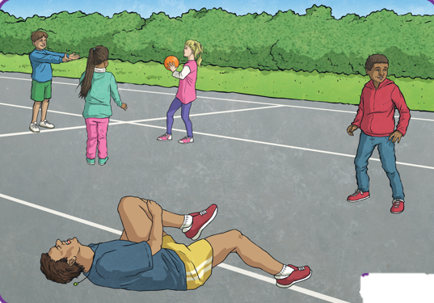
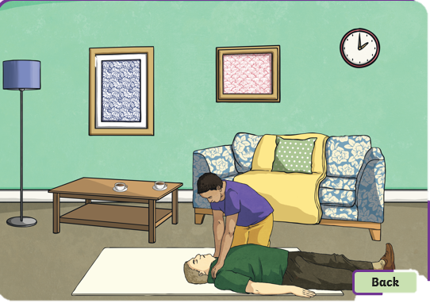
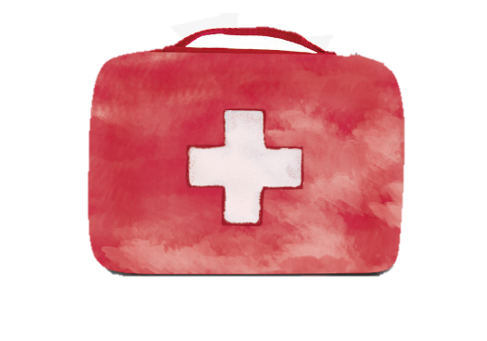
I know why I would call for help and how
What has happened in these two pictures?
What would you do? Would you do anything at all?
Notes:
ACTIVTY:
Ask children what has happened in these two pictures? What do they think has happened? What would they do first? What do they think they need to ? Would they do anything at all?
Pic 1: maybe just been accidently kicked but could also have a broken leg – note person is obviously conscious so will probably be able to tell you how he is
Pic 2: doesn’t look like the casualty is conscious. There is no one else in the room so the best thing would be to ring 999 or 112
AIM: We want children to be confident about some of the reasons why they would call for help.
Ask children if they can think of any other reasons why they might need to call for help?
For example, a fire, when they see something that scares you, if they see someone in trouble, maybe lots of bleeding, someone not responding,

Slide 5
What do I need to do in an emergency?
The role of a first aider is to:
keep yourself and the casualty safe;
stop anyone getting any further injuries;
quickly and safely treat any injuries;
get help from the emergency services, if needed.
Notes:
Anyone can be a first aider. The lessons in the book will help you to learn some important skills so that you can give injured people first aid.

Slide 6

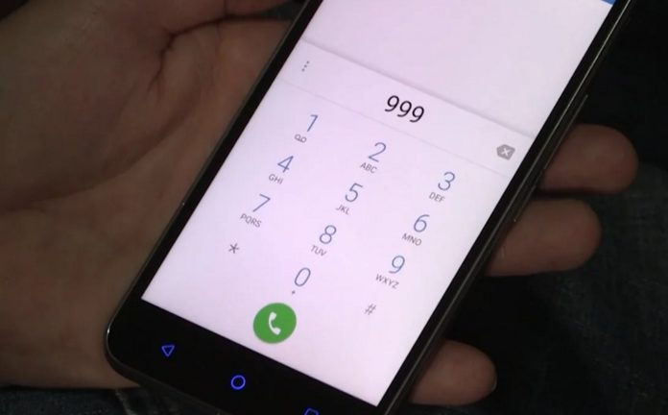
999
Or
112
Notes:
Sometimes, the casualty will need a lot more help than you are able to give. The best thing you can do is phone for emergency help.
Which two telephone numbers can you ring? Ask children if they know?
999 or 112.

Slide 7
What will I be asked?
Which emergency service do you require?
What is your name?
Where are you?
What has happened?
How many people are hurt?
When you have answered these questions, stay on the phone. You can put the phone on loud-speaker if you need to. The operator will give you more information about how you can help the casualty.

Slide 8
Step by Step
1. Is it safe?
2. Shout for help
3. Call 999 or 112
4. Go to the First Aid Box
5. Apply First Aid
Notes:
ACTIVITY: Set up different scenarios and ask children to role play these at the front of the group. For example, a child has fallen over and bumped their head – pretend their head is bleeding a little. A small group of children to take on the role of a First Aider. Go through the process of what they need to do. Is it safe? Shout for help? Call 999 or 112, which emergency service do they need to help? First Aider attends to the scene using the First Aid kit.
Resources: First Aid Kit, Police hat, Fire Hat, Doctors coat, Bandages, Toy Phone etc.

Slide 9
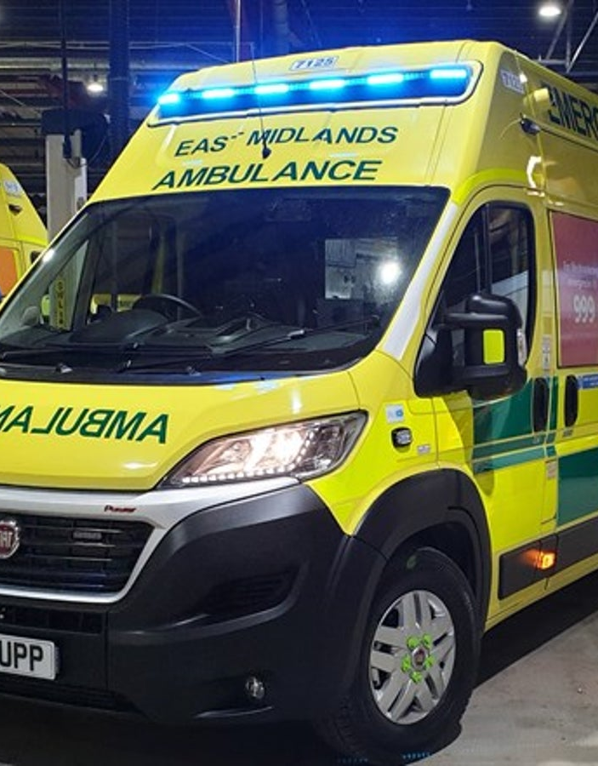
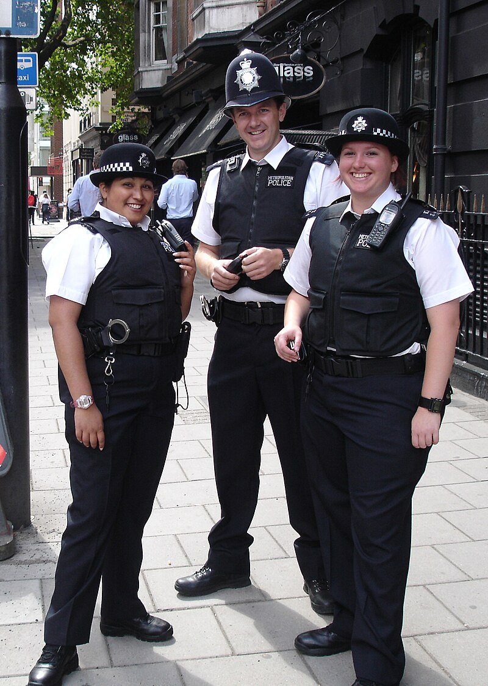
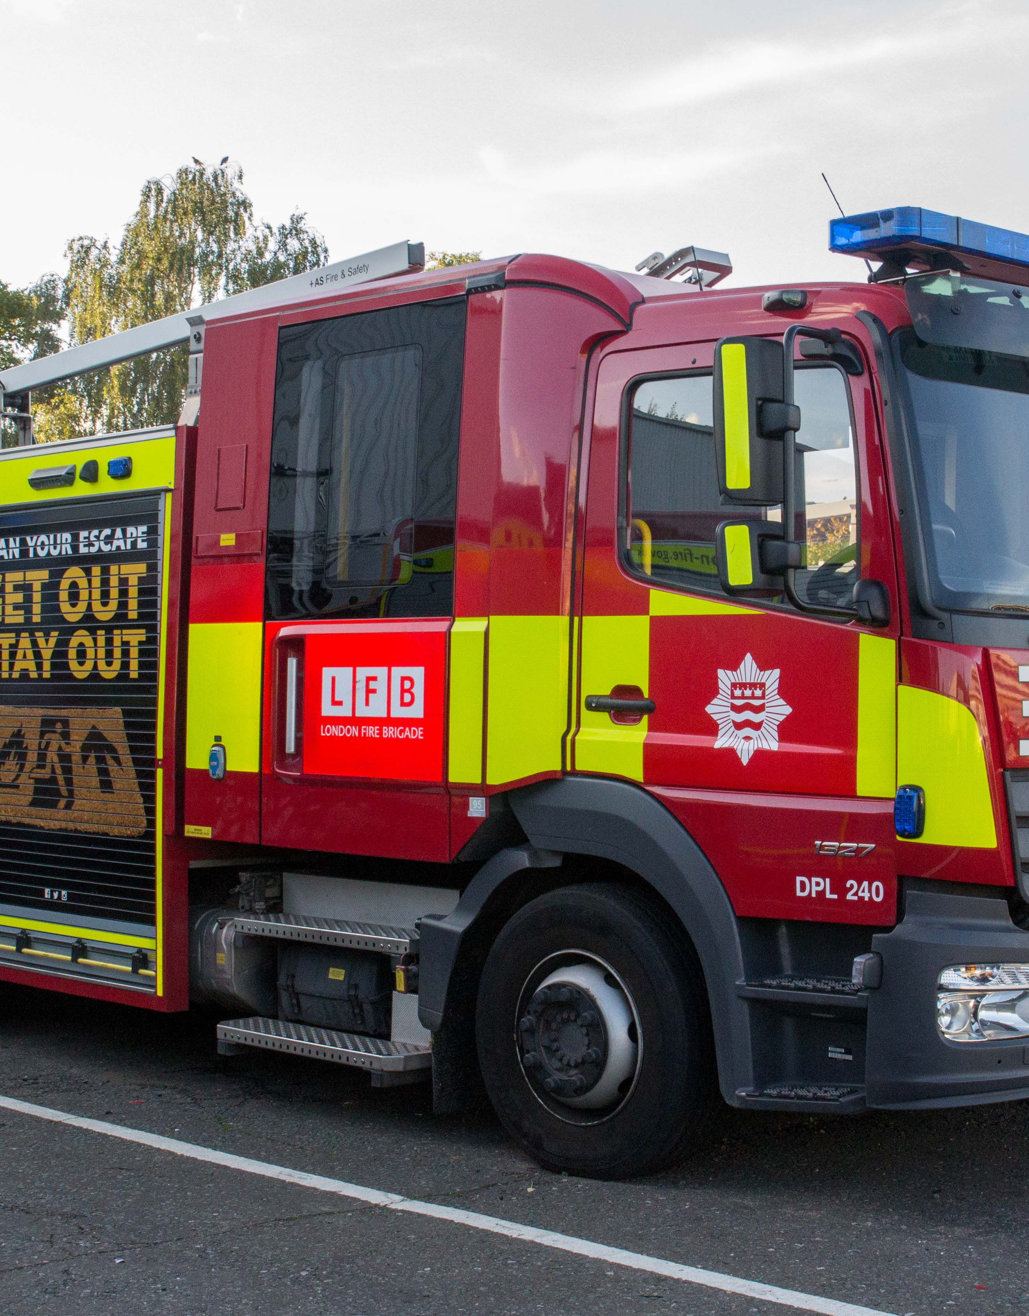
Shouting for help
Notes:
Activity: If children have seen something which doesn’t look right, children should call for help. Allow children practice to shout ‘Help’ in a big loud voice on the count of 3.
Practice.
Ask children who they could ask for help? Who In their family, household, street? Ask children to think about what emergency services they could call? What does each of them do? (Ask before the images are displayed on the slide).
Being faced with a situation where someone has been hurt can be upsetting or may cause you to panic. If you feel yourself starting to panic, take slow, deep breaths to calm yourself down.
After the casualty has been treated, you may feel:
happy and proud;
confused;
angry;
sad or upset.
All of these feelings are completely normal. Talk to an adult you trust about what happened. They will be able to help you and put your mind at rest.

Slide 10
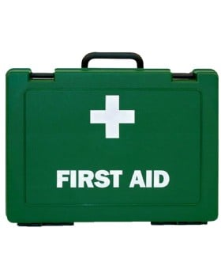
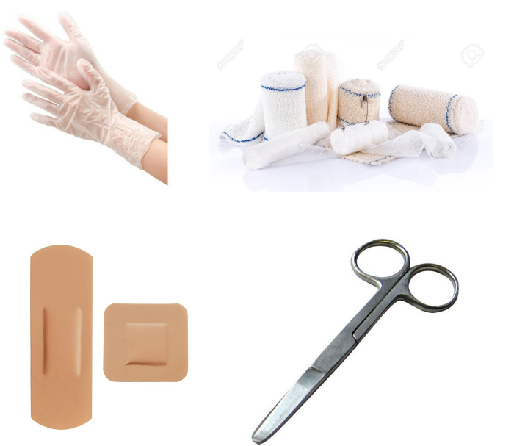
I know where the First Aid kit is
Notes:
Where is the first aid kit at the child’s home? Where is the closest first aid kit to the child’s room at nursery?
ACTIVITY: Show children a First Aid Kit and talk about what can be included within the First Aid kit.
Hands up what these items are and what they are used for: Gloves - To stop germs spreading. Bandages - To wrap big cuts, provide support. Plasters - To put on small cuts. Scissors - To cut bandages/clothes

Slide 11

Any questions?
Notes:
If there is any time left, does anyone have any questions?
Thank you for inviting me to your assembly and I hope you learnt something this morning and you enjoy the sessions you’ll do with Ruffles the Train Dog book and his adventures in learning What If ….. I needed first aid

