Slide 1
Plastic Pollution
Sustainable Communities
Notes:
Slide 1 – This session is all about plastic pollution. Plastic pollution involves the accumulation of plastic products in the environment that adversely affects wildlife, wildlife habitats and humans. Plastics that act as pollutants are categorised into micro, meso or macro debris depending on size. Plastics dominate human life, but they can take centuries to biodegrade

Slide 2
Notes:
Slide 2 - Ask the students if they watched the programme Blue Planet II. The final episode showed the devastating impact of humans on the world’s seas and now the spotlight has been placed on the scale of destruction caused by the use of excessive plastics. Many throw away and single use products such as drinks bottles, nappies and cutlery end up the natural environment.

Slide 3
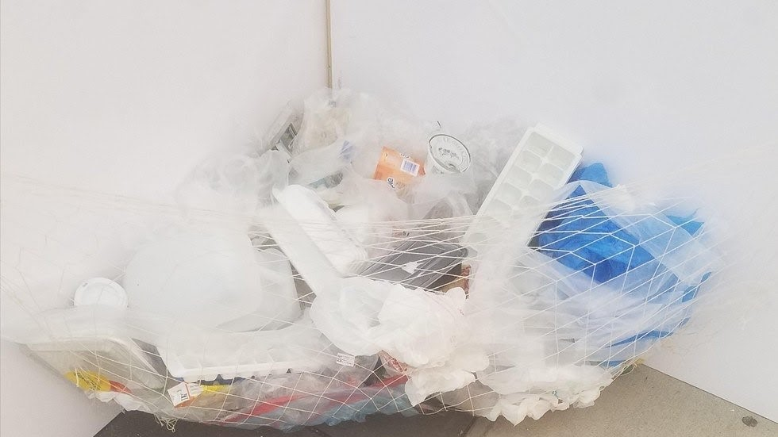
Shocking Facts
Every half a second, this much plastic makes it into the ocean
Notes:
Slide 3 – Did you know that every half a second, this much plastic makes it into the ocean? Think how much has made its way into the ocean in just the time it’s taken for me to tell you this.

Slide 4
Shocking Facts
At least 8 million tonnes of plastic enter the oceans each year
More than 50% of sea turtles have consumed plastic
Cigarette ends, plastic bags, fishing equipment, food and beverage containers are the most common forms of plastic in the ocean
For every bit of plastic that is ever produced it is still with us, in some form
Notes:
Slide 4 – at least 8 million tonnes of plastic enter the oceans each year, that's equivalent to 16 shopping bags full of plastic for every metre of coastline.
More than 50% of sea turtles have consumed plastic. Scientists have found that creatures at the bottom of the food chain are ingesting plastics floating on the surface of the ocean.
At the current rate, it is predicted that the ocean will contain more plastics than fish by 2050.
Cigarette ends, plastic bags, fishing equipment, food and beverage containers are the most common forms of plastic in the ocean
For every bit of plastic that is ever produced it is still with us, in some form
Read each slide

Slide 5
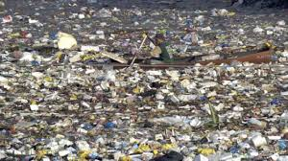
Great Pacific Garbage Patch
Notes:
Slide 5 - The Great Pacific Garbage Patch is a collection of marine debris in the North Pacific Ocean mostly made up of microplastics. The Great Pacific Garbage Patch also known as Pacific trash vortex, spans from the West Coast of North America to Japan. It is estimated to be twice the size of France and predicted that it will double in size in the next 10 years if we don’t change our ways. According to the UN environmental programme, the great Pacific garbage patch is growing so fast that it, like the Great Wall of China, is becoming visible from space.

Slide 6
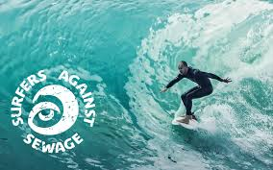
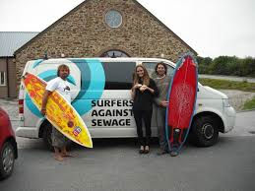
Surfers Against Sewage
Notes:
Slide 6 - There are lots of charities working to help protect our oceans from plastic pollution. Surfers against sewage, marine conservation society and Greenpeace are a few of the marine conservation charity working with communities to protect oceans, beaches and Marine life.

Slide 7
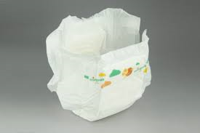
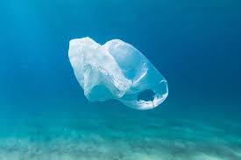
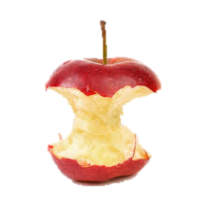
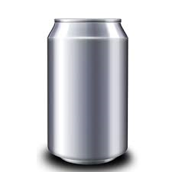
Activity Bio-degrade Game
Notes:
Slide 7 - You will each be given a box of assorted items along with some cards stating how long each item would take to decompose.
Work in your teams to match the card to the product.
You have 10 minutes to complete this activity

Slide 8
The Results
Items | Length of time to Biodegrade
Nappy | 450 Years
Orange Peel | 2 years
Banana Peel | 4 weeks
Paper | 3 weeks
Aluminium Can | Million Years
Cardboard | 2 months
Plastic Bottle | 450 years
Tin can | 50 years
Glass | 2 million years
Styrofoam Cup | 50 years
Plastic Bag | Over 20 Years
Notes:
Slide 8 - Lets have a look as the results. Go through results.
Plastics can take hundreds of years to break down and when they do they break down into tiny microplatistics which may never truly break down. These can enter our food chain when consumed by marine animals.

Slide 9
What do you use that is made of plastic?
Notes:
Slide 9 – Have a think about all the things you use that’s made of plastic.
Get students to name things

Slide 10
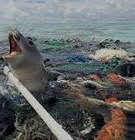
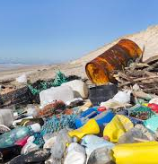
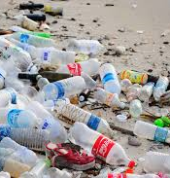
How Can You Help?
Notes:
Slide 10 – So we use a lot of plastic items. A lot are only used once and then thrown away. What do you think we can do to help?

Slide 11
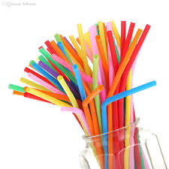
How you Can Help…
Reduce our use of single plastics
Use reusable bottles / bags
Refuse straws
Avoid access packaging
Avoid products with micro beads
Become a plastic free school
Spread the word
Notes:
Slide 11 - Go through how they can help

Slide 12
Thank you for listening

