Slide 1
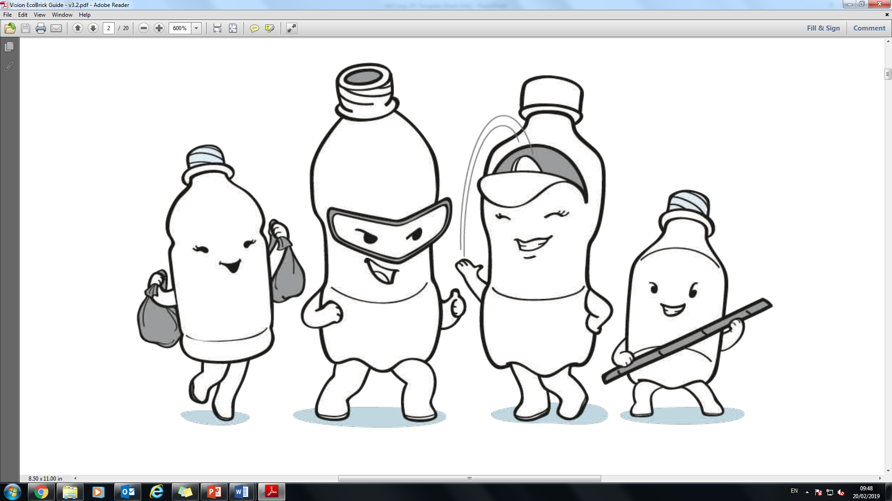
Ecobricks Workshop

Slide 2
DID YOU KNOW. . .
A million plastic bottles are bought around the world every minute. These bottles are only used once, and then they are put in the bin. This is why we call them single-use plastics, and it is not just plastic bottles. Plastic bags, wrappings, disposable plastic forks, and crisp packets are just a few examples.
These plastics either end up in our environment or in landfill, where they can take up to 1000 years to decompose! This means that these plastics are filling up our environments, and as a result are harming both humans and animals.

Slide 3
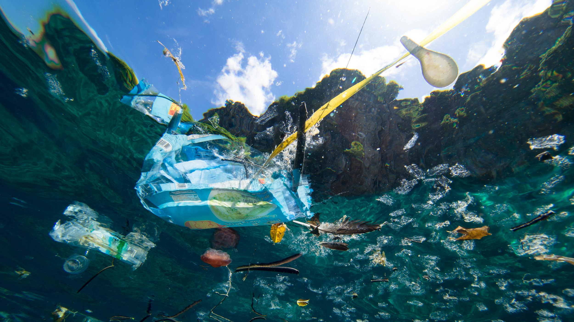
WHERE DOES ALL THE PLASTIC GO?
When all of this plastic ends up in landfills or in our environment, it is often washed into streams, rivers and oceans.
Scientists are starting to realize just how much plastic are now in the ocean, impacting the fish and other wildlife who live in the water.
Have you ever been to the beach and seen plastic washed up onto the shore? More and more we are recognising the effects this is having on marine animals and ecologies, And on our planet as whole.

Slide 4
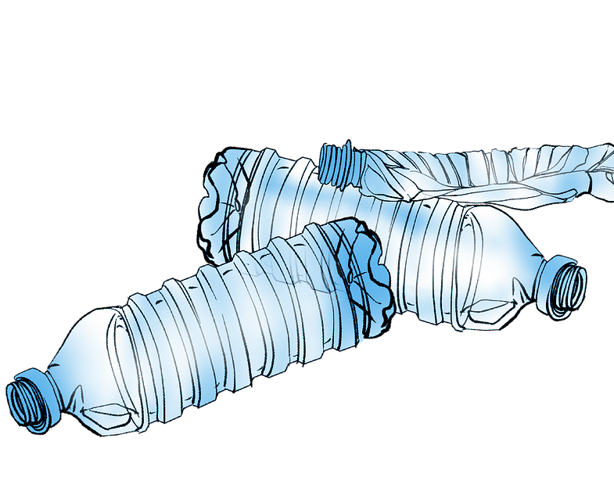
DID YOU KNOW. . .
While recycling does help to reduce the amount of plastic going into our environment, it is not a perfect solution.
Plastics can be lost in the process, and plastic can only be recycled a limited number of times. Even the highest quality plastic is eventually becomes no longer recyclable.
All of this plastic ends up in our environment. Plastics don’t biodegrade like plants do, they photodegrade. This means that as they slowly break into smaller
and small pieces, they also
release dangerous chemicals.

Slide 5
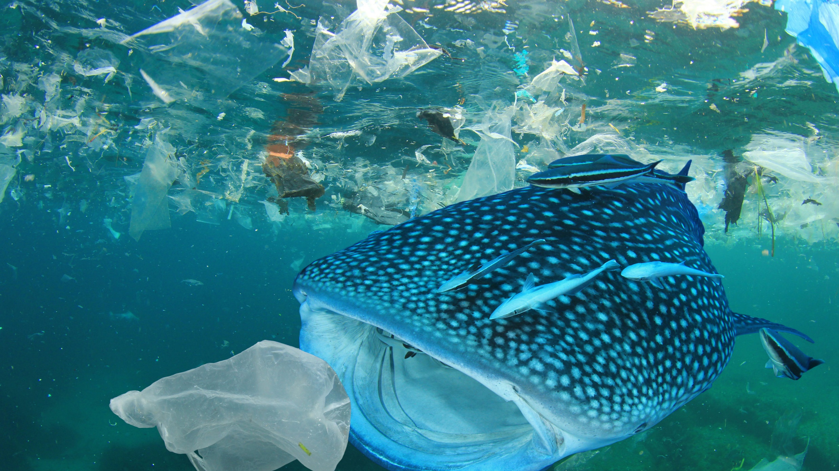
By 2050 there will be more plastic in the oceans than there are fish!

Slide 6
WHAT CAN WE DO ABOUT IT?
While making sure that we try and reduce the amount of plastic we are using, and recycling as much of it as we can, there is another way that use up our single-use plastic rubbish.
Eco bricks are a new way to use the waste plastic that would otherwise end up in a landfill or in the ocean.
Luckily, eco bricks are easy to make and you can help! Today we are going to show you how to make your own eco bricks, and we hope you will help us make lots more!

Slide 7
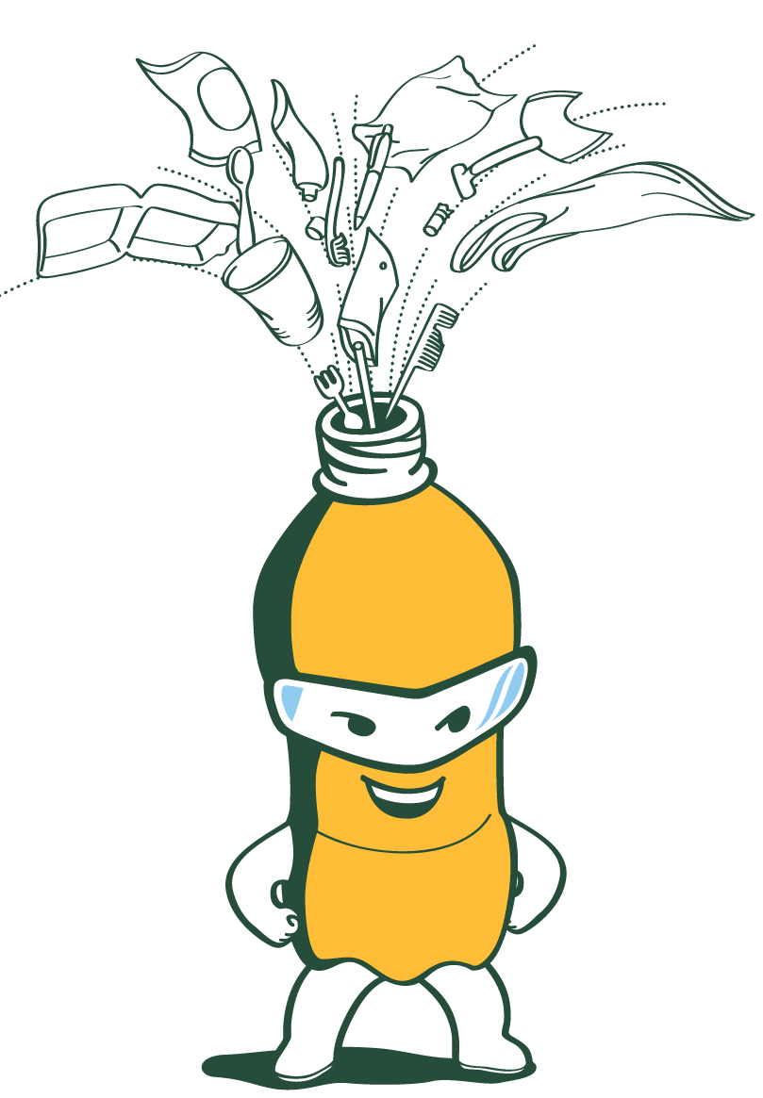
WHAT ARE ECO BRICKS?
An Eco brick is a reusable building block created by packing clean and dry used plastic into a plastic bottle. By filling the plastic bottle, it makes it strong enough to act like a brick!
Eco bricks enable us to take personal responsibility for the plastic we are using, rather than letting it be dumped into the environment.
Around the world people are using ecobricks to build in a whole new way.
From indoor furniture, to gardens and parks, to structures – there are so many things ecobricks can be used to make!

Slide 8
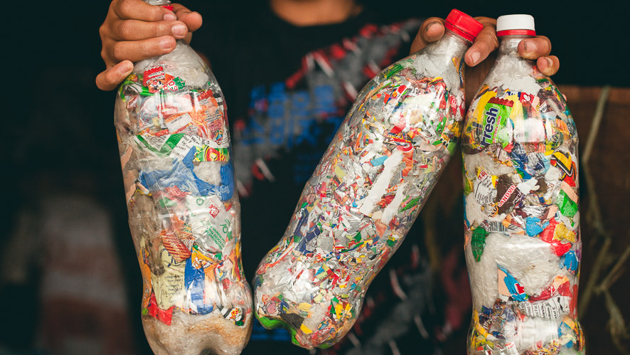
This is what your eco brick should look like!

Slide 9
HOW DO YOU MAKE AN ECO BRICK?
Eco bricks are simple and fun to make! Follow the easy step by step process below to make your own!
To start, you will need a 1.5-2 litre bottle. Fill your bottle with non-biodegradables materials. You can use all kinds of plastics, foams, different types of packaging and cellophanes.
Make sure not to use any paper, glass or sharp metal!
Use a stick to pack the bottle as tightly as possible. An easy tip to make sure your bottle is completely full is to start with a soft coloured plastic first to make sure to fill all the bottle’s bottom corners and any air pockets.
Seal the bottle with its original lid and you’ve made an eco brick!

Slide 10
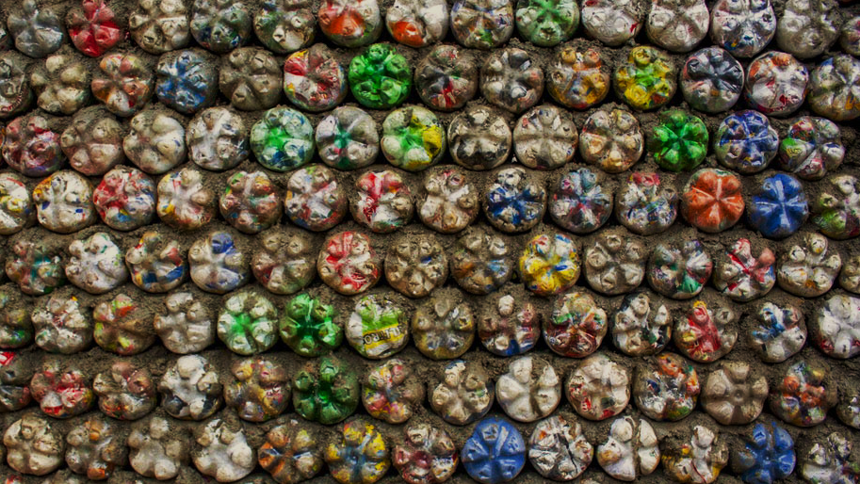
HOW ARE ECO BRICKS USED?
The eco bricks you make will be used to make a turkey pen and bench for Fairytale Farm in Chipping Norton!

