Slide 1
Earth Hour
Add date xxx | 8:30pm – 9:30pm
Notes:
As part of our Sustainable Schools Campaign I am hear to talk to you today about Earth Hour.
Ask Pupils – Can anyone tell me what Earth Hours is?
Earth Hour is a global movement which brings millions of people together from all across the world to call for greater action on climate change. Each year hundreds of people of people from across the world switch off their lights and organise events at home and their communities to care about the future of our planet.

Slide 2

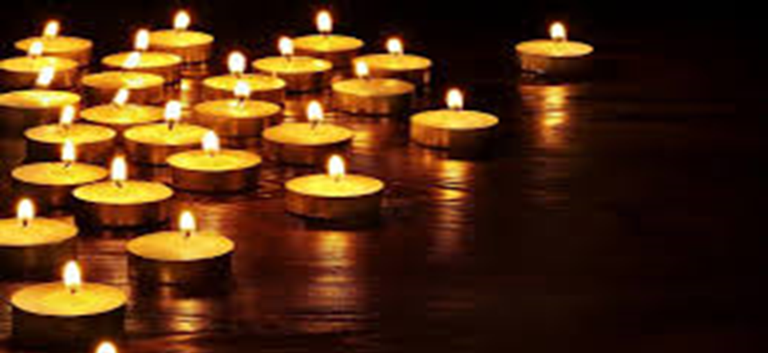
Lights Out For Earth Hour
Notes:
On Saturday 30th March between the hour of 8.30am – 9.30pm each one of us can be a hero to save our planet and all you need to do is switch your household lights, unplug you TV, radio and X box off for one hour. Gather your friends and family to light candles and complete an activity in the dark, such as a walk stargazing, a candlit meal, story telling by candlelight, playing board games

Slide 3


What is Climate Change?
Notes:
sk the children what is Climate Change
Climate change is happening and it is caused by a large part of human activity and it will have many serious and potentially dangerous effects in the years ahead. Green house gas emissions from cars and powerplants and other man made sources are the primary cause. The greenhouse gases act like a blanket trapping the sun’s warmth near the earths surface affecting the planets climate system

Slide 4

Planet in Crisis
80% less of fresh water animals
Over 50% less land animals
40% of our forests have disappeared to farming land with 15 million trees lost each year
1 in 6 of the planets animals are at risk of extinction from climate change
Notes:
And as a result of this we are now up against the biggest environmental threats that our generation has ever faced.
Wildlife such as elephants, turtles and polar bears are at risk from the effects of climate change, pollution and over- consumption. The damage is happening shockingly fast

Slide 5
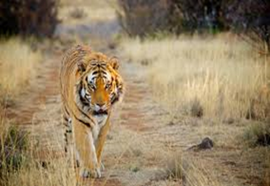
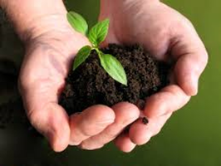

We can fix this by…
Working to reduce gases from burning fossils like coal, oil and gas
Restoring and protecting animals homes
Looking at our food chain to ensure that we are farming sensibly, reducing waste and eating responsibly
Notes:
So what are we doing to fix it…..
Burning Fossil Fuels – Using renewable energy such as wind power and solar power
Restoring animal homes
Food Chain – From where food is grown to be sold

Slide 6

Helping poorer countries cope with climate change
Encouraging everyone to make sustainable lifestyle choices
Can anyone give me an example of what changes that we can make to help the planet?
Notes:
Read slide
Ask the pupils to give examples of what changes we can do to help the planet

Slide 7
How we can help
Do not leave mobile phones on charge
Do not leave lights on
Turn off the tap when brushing your teeth
Walk or ride you bike instead rather than using a car
Recycle, Re-use and Refill
Reduce the amount of plastic you use i.e Straws
Do not drop litter
Notes:
Read through the list …. Ask pupils if there are any other examples that can suggest

Slide 8
Add Date
8:30pm – 9:30pm
Notes:
As part of our Sustainable Schools Campaign I am hear to talk to you today about Earth Hour.
Ask Pupils – Can anyone tell me what Earth Hours is?

Slide 9
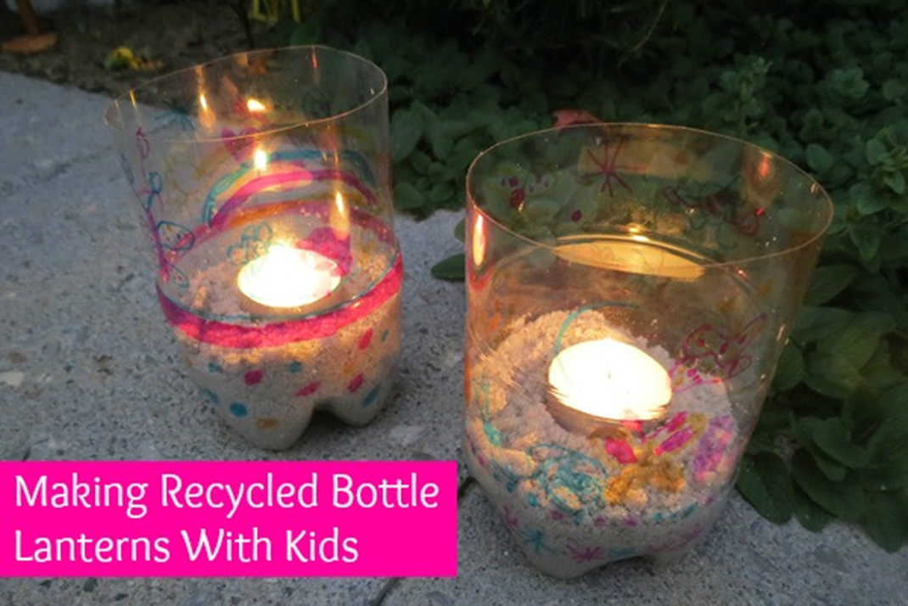
Notes:
Today to help you celebrate Earth Hour we are going to make some recycled plastic bottle lanterns

Slide 10
How to do it…
Use scissors to cut your bottle to the size you require
01
Decorate the outside of your bottle with decorations, tissue paper etc
02
Insert a layer of sand in the bottom of your lantern
03
Insert your LED battery light
04
Admire your Earth Hour lantern
05
Notes:
Read through

Slide 11
Thank You

